Slide 1
The GreenBin Project Proposal
Team Kiger Mustang: Bernard Milaj, Brady Esplin, Gabriel Sudyka

Slide 2
The GreenBin:
Is a self-sorting recycle bin stand alone structure above a normal dumpster/skip to solve the problem of recycling contamination.
Powered by 120v or 240v electrical cord with Solar Power options and a long-life lead-acid or lithium-ion battery included.
Paper Goods, Plastics, Glass, and Metals go into reusable reinforced canvas/hemp sacks.
When sack is full, it is deposited into the dumpster/skip underneath the GreenBin.

Slide 3
Justification
The greatest challenge to the sustainability practice of recycling used consumer goods and containers is recycling contamination, which occurs from improperly cleaned recycled goods and improperly sorted recycled items.
By sorting recycled items at the source, this would allow recycling companies to wash or treat the recycled goods as needed without further concern about improper sorting.
For over two decades China bought a large amount of American recycled materials. Over time the goods became increasingly contaminated as it is cheaper to collect materials in a “single-stream” vs pre-sorting the materials.
In 2017, China began Operation National Sword, denying the purchase of any amount of recycled material that is more than 0.5% contaminants.
Since this recycling stream has been interrupted, the majority of the formerly recycled goods have gone to landfills in the United States or have been burned to convert the recycling to electricity, spurring concerns about air pollution.
The GreenBin would sort materials to be recycled at the source, allowing waste management companies to once again profit from the sale of recycled materials to China.
Notes:
Gabe- I will try and find cost increases or decreases each time new tech is introduced to this process. Google driven research=)
Brady- I think I need to be clearer about how this tech will benefit consumers, waste management, govmt, etc.

Slide 4
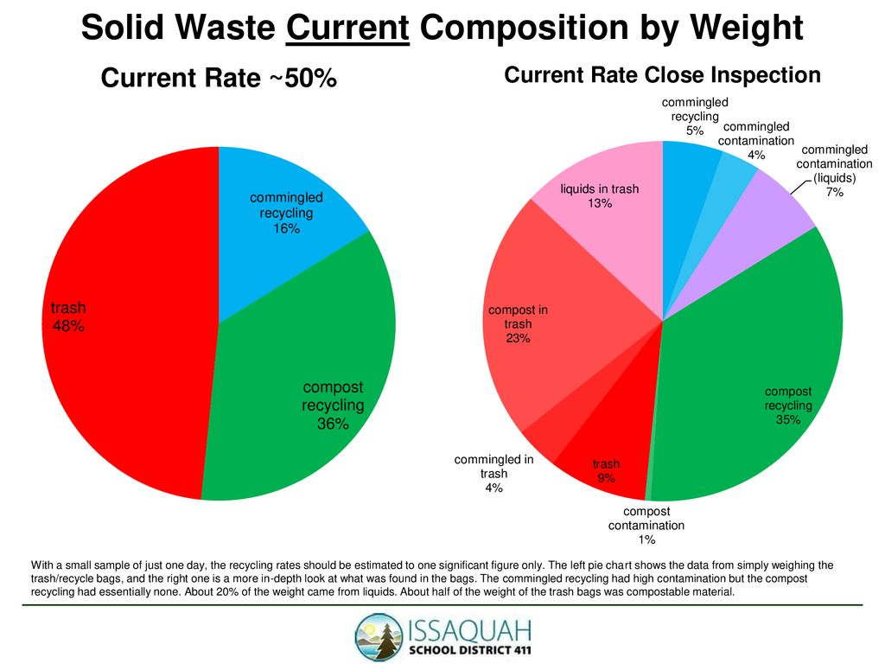
Above is a one-day sample study from one high school showing the amount of contamination present in recyclables, trash, and compost.
Notes:
Brady- This information is from one high school in middle America, this is just to show small-scope how much recycle is contaminated.

Slide 5
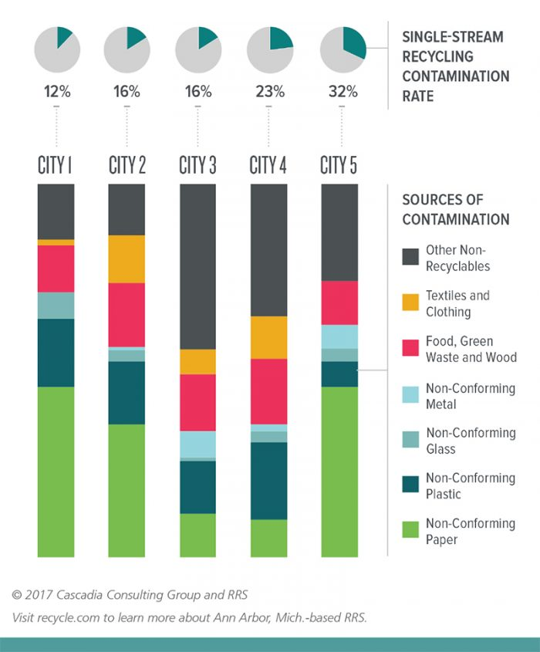
Above is a bar graph showing the items that contaminate single-stream recycling in a study of five anonymous cities.

Slide 6
Project Scope
This project is:
A recycled materials sorter, with sorting visible from the outside of the product
A recycled materials bagger, that can signal when it is full, or a fault is detected
A standalone solar and plug-powered structure overhanging a recycle dumpster/skip
This project is not:
A recycled materials cleaner
A plastics sorter
A solar energy power source
Notes:
Brady- This page looks slightly bare, should we find more to put in here or is it good as is?
Gabe- Under it can signal, we should add a note that we are looking to see if it can be integrated into current systems(traffic, 911 call centers, etc…) Brady- are you talking about if it catches fire or something? I am thinking that the owners of these devices would be waste collection and management companies, and that they would need to provide some sort of operations center to monitor the fullness/faults of the machines.

Slide 7

Project Outcomes
At the end of this project:
We will have a working prototype of a stand-alone structure that collects solar energy when in sufficient sunlight, sorts recyclable materials by type, bags said materials for pickup, grabs and lifts collection containers for customers, and tracks data on amount of recycled materials is collected.
It will be good for the planet and profitable for waste management companies.

Slide 8
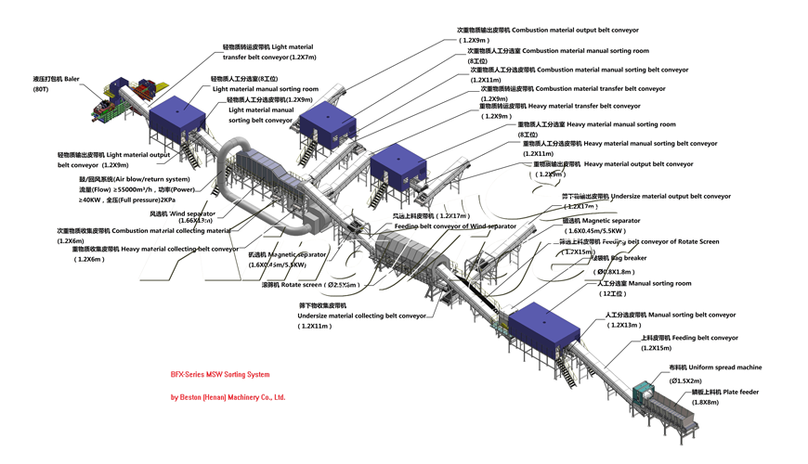
What we would be replacing

Slide 9
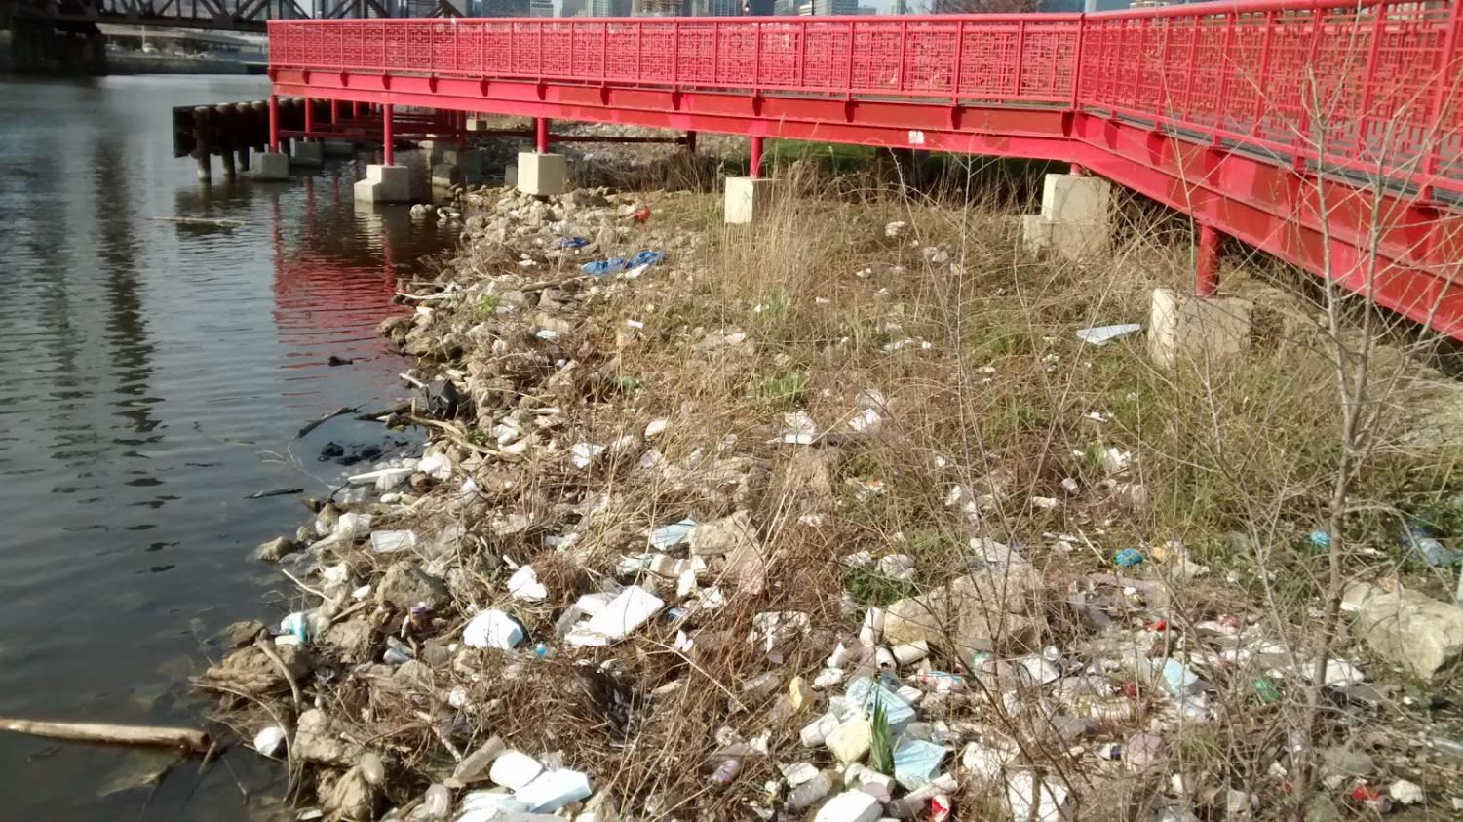
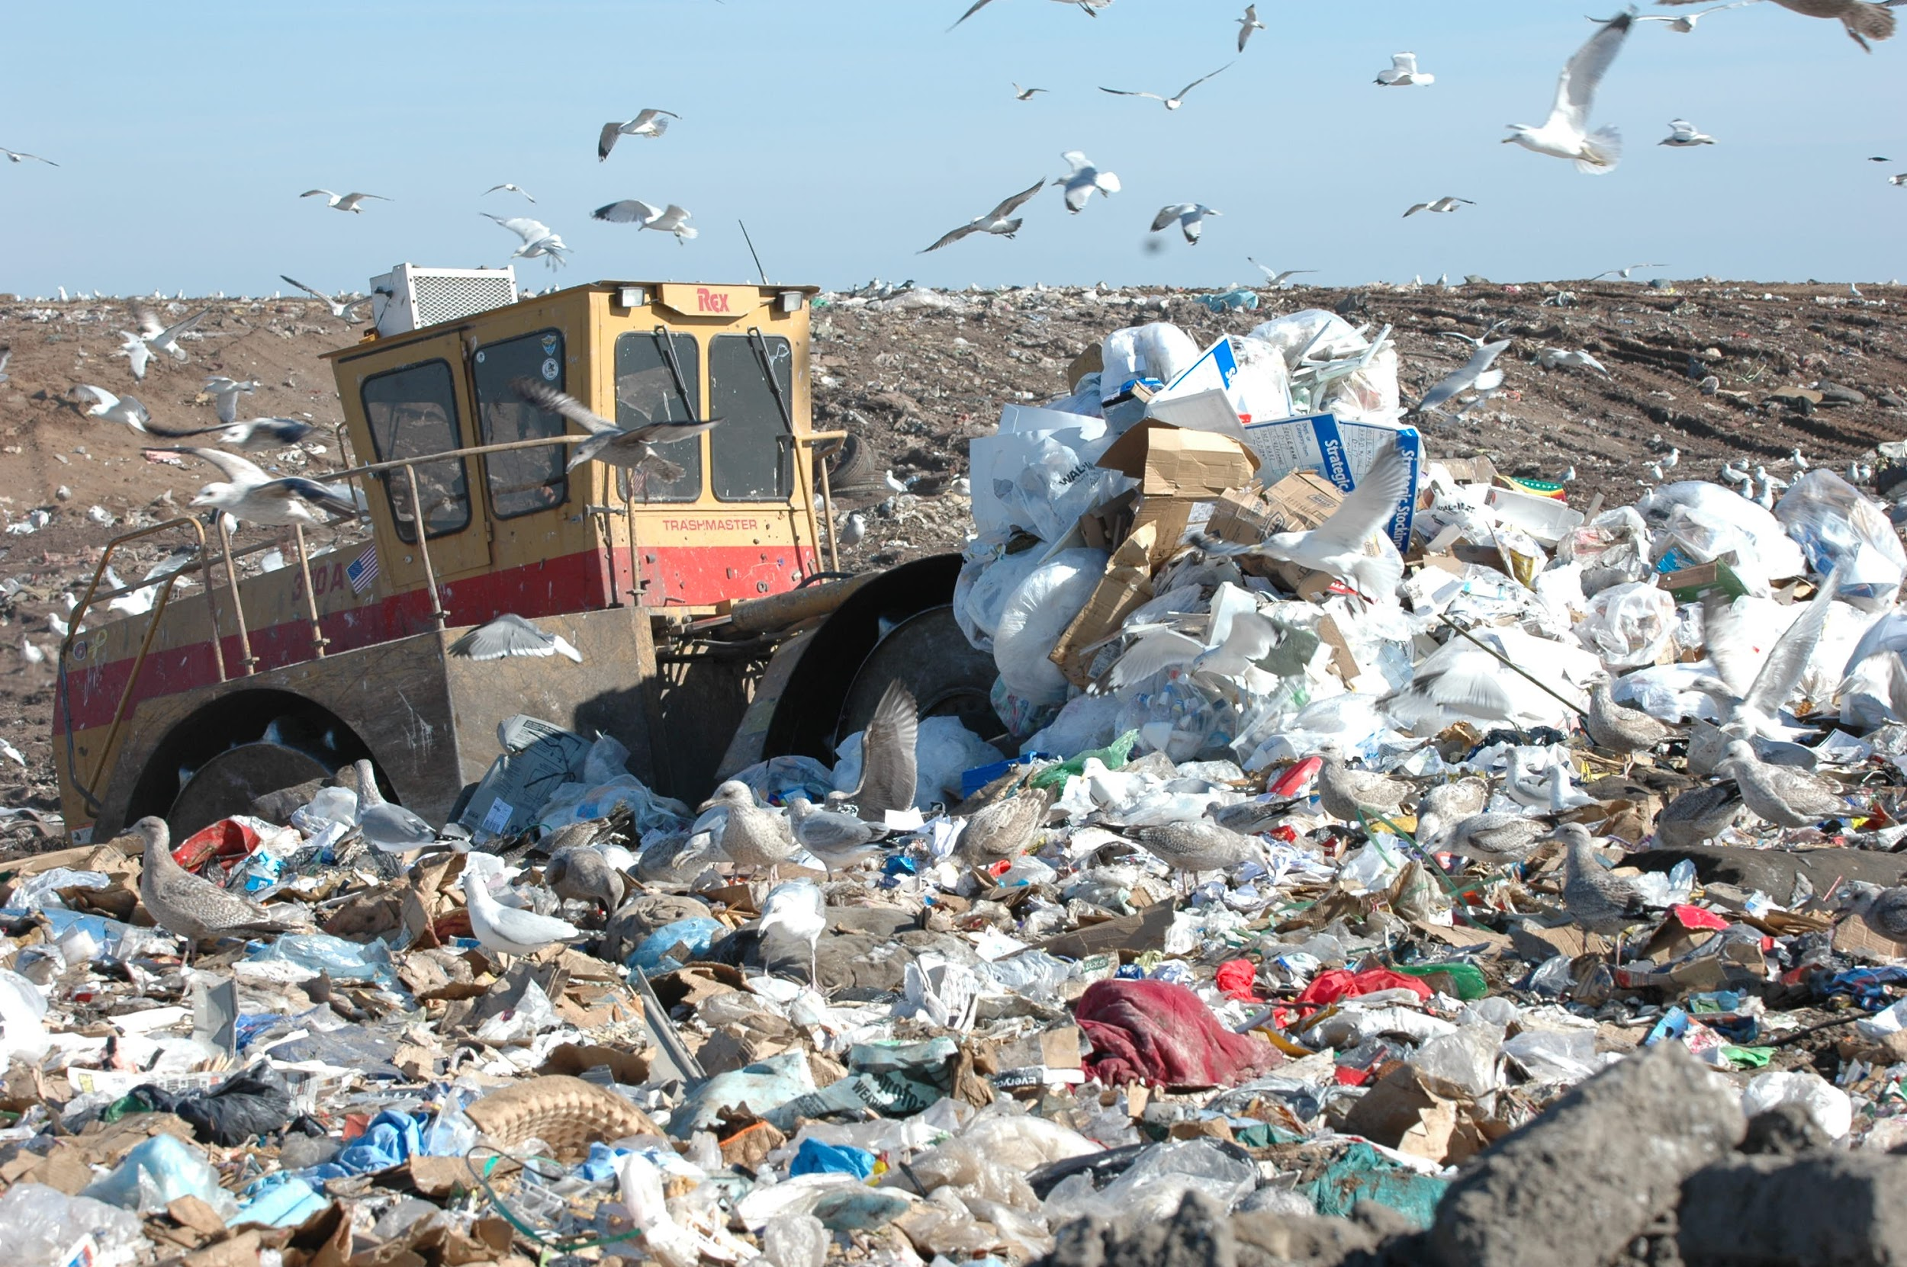
What we are trying to prevent

Slide 10
Project Structure
The Project Manager position will rotate by first-name alphabetical order on a weekly basis, other roles will be
assigned by the Project Manager as needed.
This document:
Bernard - Original Idea and project refinement
Brady - Organizing and notes
Gabriel - Research and feedback

Slide 11

Questions?
Research and feedback

Slide 12
Sources
Recycling - Wikipedia
What is Recycling Contamination, and Why Does it Matter? (rubicon.com)
Operation National Sword - Wikipedia
Contamination in Recycling Costs Businesses Money - Miller Recycling
Piling Up: How China’s Ban on Importing Waste Has Stalled Global Recycling - Yale E360
A Cost-Benefit Analysis of Recycling in The U.S. | Manhattan Institute (manhattan-institute.org)
Pine Lake Middle School Cafeteria Waste Audit - ppt download (slideplayer.com)
Data Corner: The dirty details on contamination - Resource Recycling (resource-recycling.com)
Notes:
Gabe- .gov, .edu type research sources look “better”.

